Slide 1

Schematron Tutorial
Declarative Amsterdam
November 7 and 8, 2022
While waiting, maybe you can do some preparations?
Go to https://da2022.xatapult.com for instructions!

Slide 2

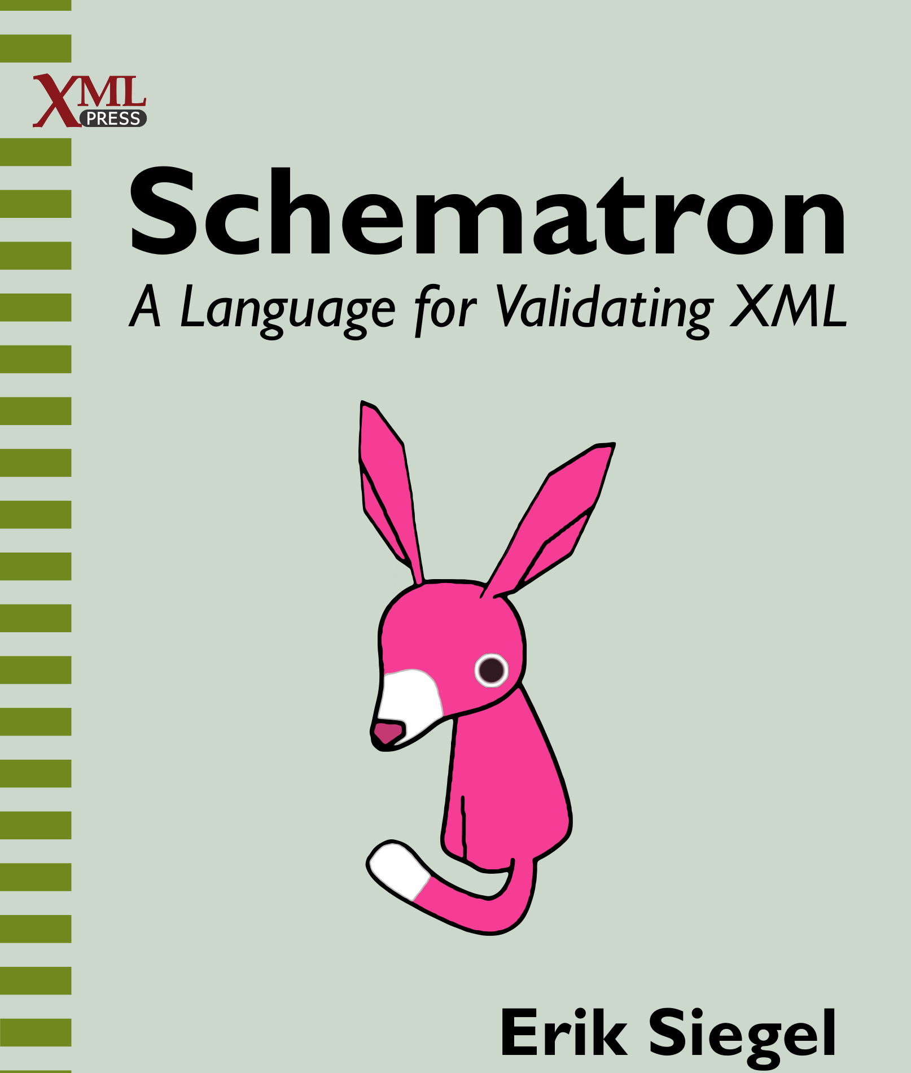
Who Am I?
Erik Siegel
Content Engineer and XML specialist
One-man company: Xatapult
Groningen, The Netherlands
Author of "Schematron – A language for validating XML"
Contact:
erik@xatapult.nl www.xatapult.com www.linkedin.com/in/esiegel/ +31 6 53260792

Slide 3
Schematron highlights
A formal XML based schema language
Two types of rules:
Assertions
Reports
Messages in your own words!
XPath based expressions
Incorporate XSLT keys and functions
I'm the Schematroll
I'm Schematron's logo!

Slide 4
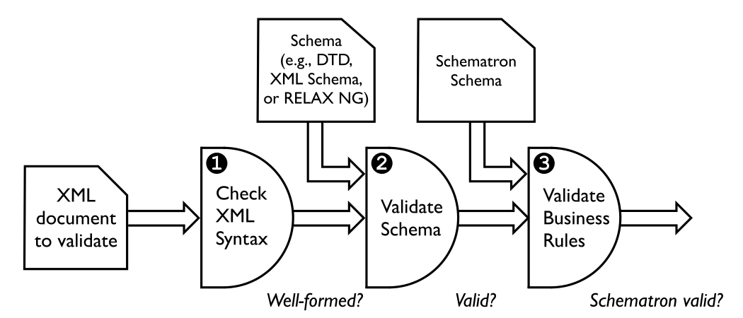
Schematron in context

Slide 5

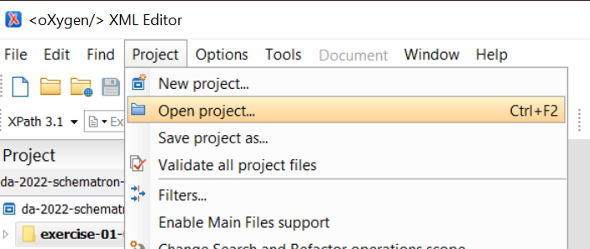
Hands-on: Installation and pre-flight check #1
Done all preparations?
Download/cloned the GitHub repository for this tutorial? https://github.com/xatapult/da-2022-schematron
A Schematron processor ready? Preferably oXygen…
When using oXygen:
Open the oXygen project: …/exercises/da-2022-schematron-exercises.xpr

Slide 6
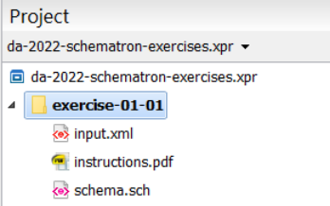

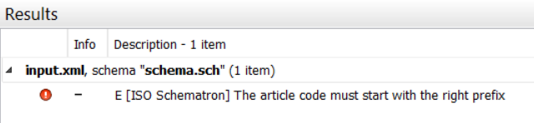
Hands-on: Installation and pre-flight check #2
When using oXygen:
Open the file …/exercises/exercise-01-01/input.xml:
Validate it by pressing the button on the toolbar
Or by using the menu option Document > Validate > Validate
Or by pressing ctrl-shift-V
You should see:
Have a look at schema.sch, the Schematron schema used

Slide 7
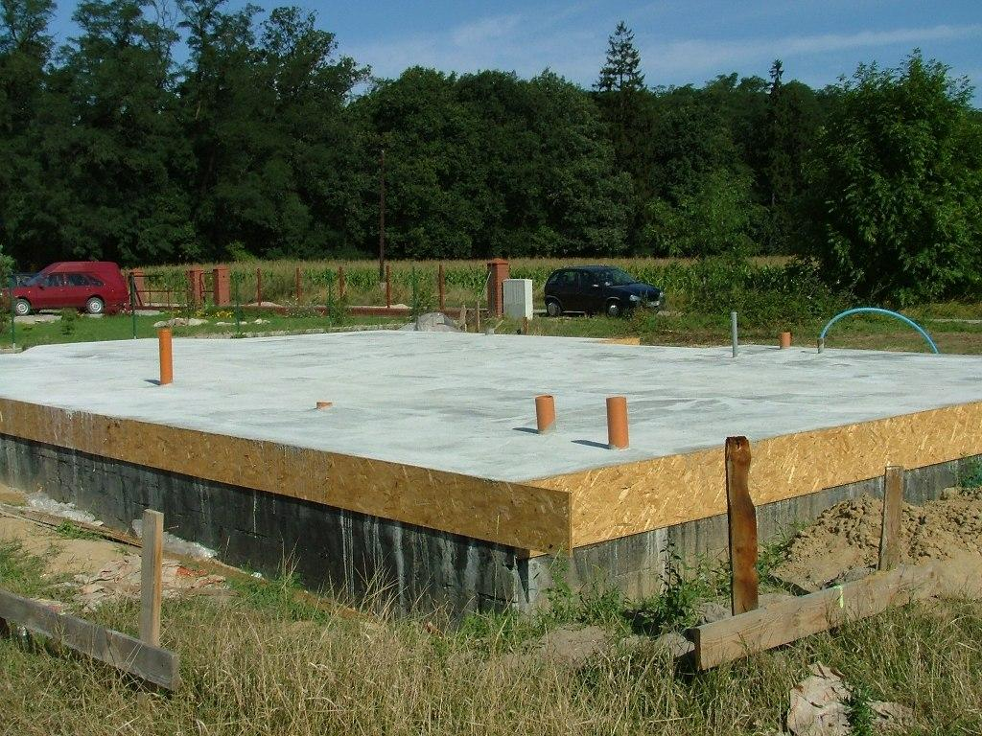
Schematron fundamentals

Slide 8
An empty Schematron schema

Slide 9
What's the result of a Schematron validation?

Slide 10
Patterns and rules

Slide 11
Assertions and reports

Slide 12
Hands-on: Assertions and reports

Slide 13
Rule processing revisited

Slide 14
Hands-on: Rule processing

Slide 15
More meaningful messages: <value-of>

Slide 16
Hands-on: Provide a better message

Slide 17
Variables: <let>

Slide 18
Hands-on: Variable usage

Slide 19
Declaring namespaces: <ns>

Slide 20
Hands-on: Validate XML in a namespace

Slide 21


Query Language Binding and using XSLT

Slide 22
Codes must start with the department code
<inventory-list depcode="IMP">
<article code="IMP0001">
<name>Bolts</name>
<description>Nuts to secure things with</description>
</article>
<article code="EXP0234">
<name>Bananas</name>
<description>Delicious ripe bananas</description>
</article>
</inventory-list>
<schema xmlns=http://purl.oclc.org/dsdl/Schematron queryBinding="xslt3">
<let name="department-code" value="/inventory-list/@depcode"/>
<pattern>
<rule context="article">
<assert test="starts-with(@code, $department-code)">
The article code (<value-of select="@code"/>) must start with the right
prefix (<value-of select="$department-code"/>) for <value-of select="name"/>
</assert>
</rule>
</pattern>
</schema>
The article code (EXP0234) must start with the right prefix (IMP) for Bananas

Slide 23
Schematron is a container language with a configurable query language for its expressions:
<schema xmlns=http://purl.oclc.org/dsdl/Schematron queryBinding="xslt3">
<let name="department-code" value="/inventory-list/@depcode"/>
<pattern>
<rule context="article">
<assert test="starts-with(@code, $department-code)">
The article code (<value-of select="@code"/>) must start with the right
prefix (<value-of select="$department-code"/>) for <value-of select="name"/>
</assert>
</rule>
</pattern>
</schema>
Query Language Binding or QLB

Slide 24
The queryBinding attribute
Specify the Query Language Binding using the queryBinding attribute on the root element (default value: xslt):
<schema xmlns=http://purl.oclc.org/dsdl/Schematron" queryBinding="…">
…
</schema>
Reserved and defined Query Language Binding names:
exslt
stx
xslt, xslt2, xslt3
xpath, xpath2, xpath3, xpath31
xquery, xquery3, xquery31
Supported Query Language Bindings (by oXygen and SchXslt):
xslt, xslt2, xslt3
Notes:
Some are outdated:
exslt: Allow exslt extension function from exslt.org (last updated: 2003)
stx (Streaming Transformations for XML) an XML based language for transforming XML documents without building a tree in memory (last update: 2007)
Contrary to what you might expect: not case-sensitive

Slide 25
Query Language Binding in practice…
Only for XSLT (and maybe XPath)
Advice:
Use xslt2 or xslt3
Always specify the QLB (using the queryBinding attribute)
Otherwise, you get the default value: xslt
which means XPath 1.0
which is rather limiting…

Slide 26
The xslt2/xslt3 Query Language Binding
Use XPath 2.0 or 3.1 expressions
Use xsl:key to define keys and the key() function for lookups
Add your own XSLT functions with xsl:function and use them in XPath expressions
Officially no other XSLT constructs, like:
xsl:include/xsl:import
xsl:template
Global XSLT variables
But this usually works fine…

Slide 27
Example of using xsl:key
<orders>
<item id="bolts" price="5.49">A box with 20 bolts</item>
<item id="nuts" price="3.78">A box with 20 nuts</item>
<!-- … many, many more items… -->
<order>
<ordered-item id-ref="bolts" quantity="5"/>
<ordered-item id-ref="nuts" quantity="10"/>
</order>
<!-- … many, many more orders… -->
</orders>
<schema xmlns="http://purl.oclc.org/dsdl/schematron"
xmlns:xsl="http://www.w3.org/1999/XSL/Transform" queryBinding="xslt3">
<xsl:key name="item-ids" match="/*/item" use="@id"/>
<pattern>
<rule context="ordered-item">
<assert test="exists(key('item-ids', @id-ref))">
The referenced item <value-of select="@id-ref"/> does not exist
</assert>
</rule>
</pattern>
</schema>

Slide 28
Example of defining a function - 1
<things>
<thing name="thing 1" type="A125" price="17.25"/>
<thing name="thing 2" type="A125" price="17.26"/>
<thing name="thing 3" type="X96" price="89.34"/>
<thing name="thing 4" type="Y78" price="10.01"/>
</things>
<type-codes-and-prices default-price="10.0">
<data type="A125" price="17.25"/>
<data type="X96" price="89.34"/>
</type-codes-and-prices>

Slide 29
Example of defining a function - 2
<schema xmlns="http://purl.oclc.org/dsdl/schematron"
xmlns:xsl="http://www.w3.org/1999/XSL/Transform" queryBinding="xslt3">
<ns uri="#functions" prefix="f"/>
<xsl:function name="f:get-price" as="xs:double">
<xsl:param name="type" as="xs:string"/>
<xsl:variable name="prices-document" as="document-node()"
select="doc('type-codes-and-prices.xml')"/>
<xsl:variable name="data-element-for-type" as="element(data)?"
select="$prices-document//data[@type eq $type]"/>
<xsl:choose>
<xsl:when test="exists($data-element-for-type)">
<xsl:sequence select="xs:double($data-element-for-type/@price)"/>
</xsl:when>
<xsl:otherwise>
<xsl:sequence
select="xs:double($prices-document/type-codes-and-prices/@default-price)"/>
</xsl:otherwise>
</xsl:choose>
</xsl:function>

Slide 30

Aside: Namespaces for expressions in Schematron
<schema xmlns="http://purl.oclc.org/dsdl/schematron"
xmlns:xsl="http://www.w3.org/1999/XSL/Transform" queryBinding="xslt3"
xmlns:f="#functions"
>
<xsl:function name="f:get-price" as="xs:double">
…
</xsl:function>

Slide 31
Example of using a function
<schema xmlns="http://purl.oclc.org/dsdl/schematron"
xmlns:xsl="http://www.w3.org/1999/XSL/Transform" queryBinding="xslt3">
<ns uri="#functions" prefix="f"/>
<xsl:function name="f:get-price" as="xs:double">
…
</xsl:function>
<pattern>
<rule context="thing">
<let name="expected-price" value="f:get-price(@type)"/>
<assert test="$expected-price eq xs:double(@price)">
The price for <value-of select="@name"/> should be
<value-of select="$expected-price"/>
</assert>
</rule>
</pattern>
</schema>

Slide 32
Hands-on: Using an XSLT function

Slide 33
Wrap-up
Schematron is defined as flexible with regards to its query language
The Query Language Binding or QLB
In practice: xslt (and therefore XPath) only
Set this using the queryBinding attribute. Recommended values:
queryBinding="xslt2"
queryBinding="xslt3"
Allows for XPath 2.0 or 3.1 expressions
XSLT2 and XSLT3 type query bindings also allow XSLT keys and functions
Other XSLT features are officially unsupported but usually work

Slide 34

Wrap up
But there is much more to explore!

Slide 35
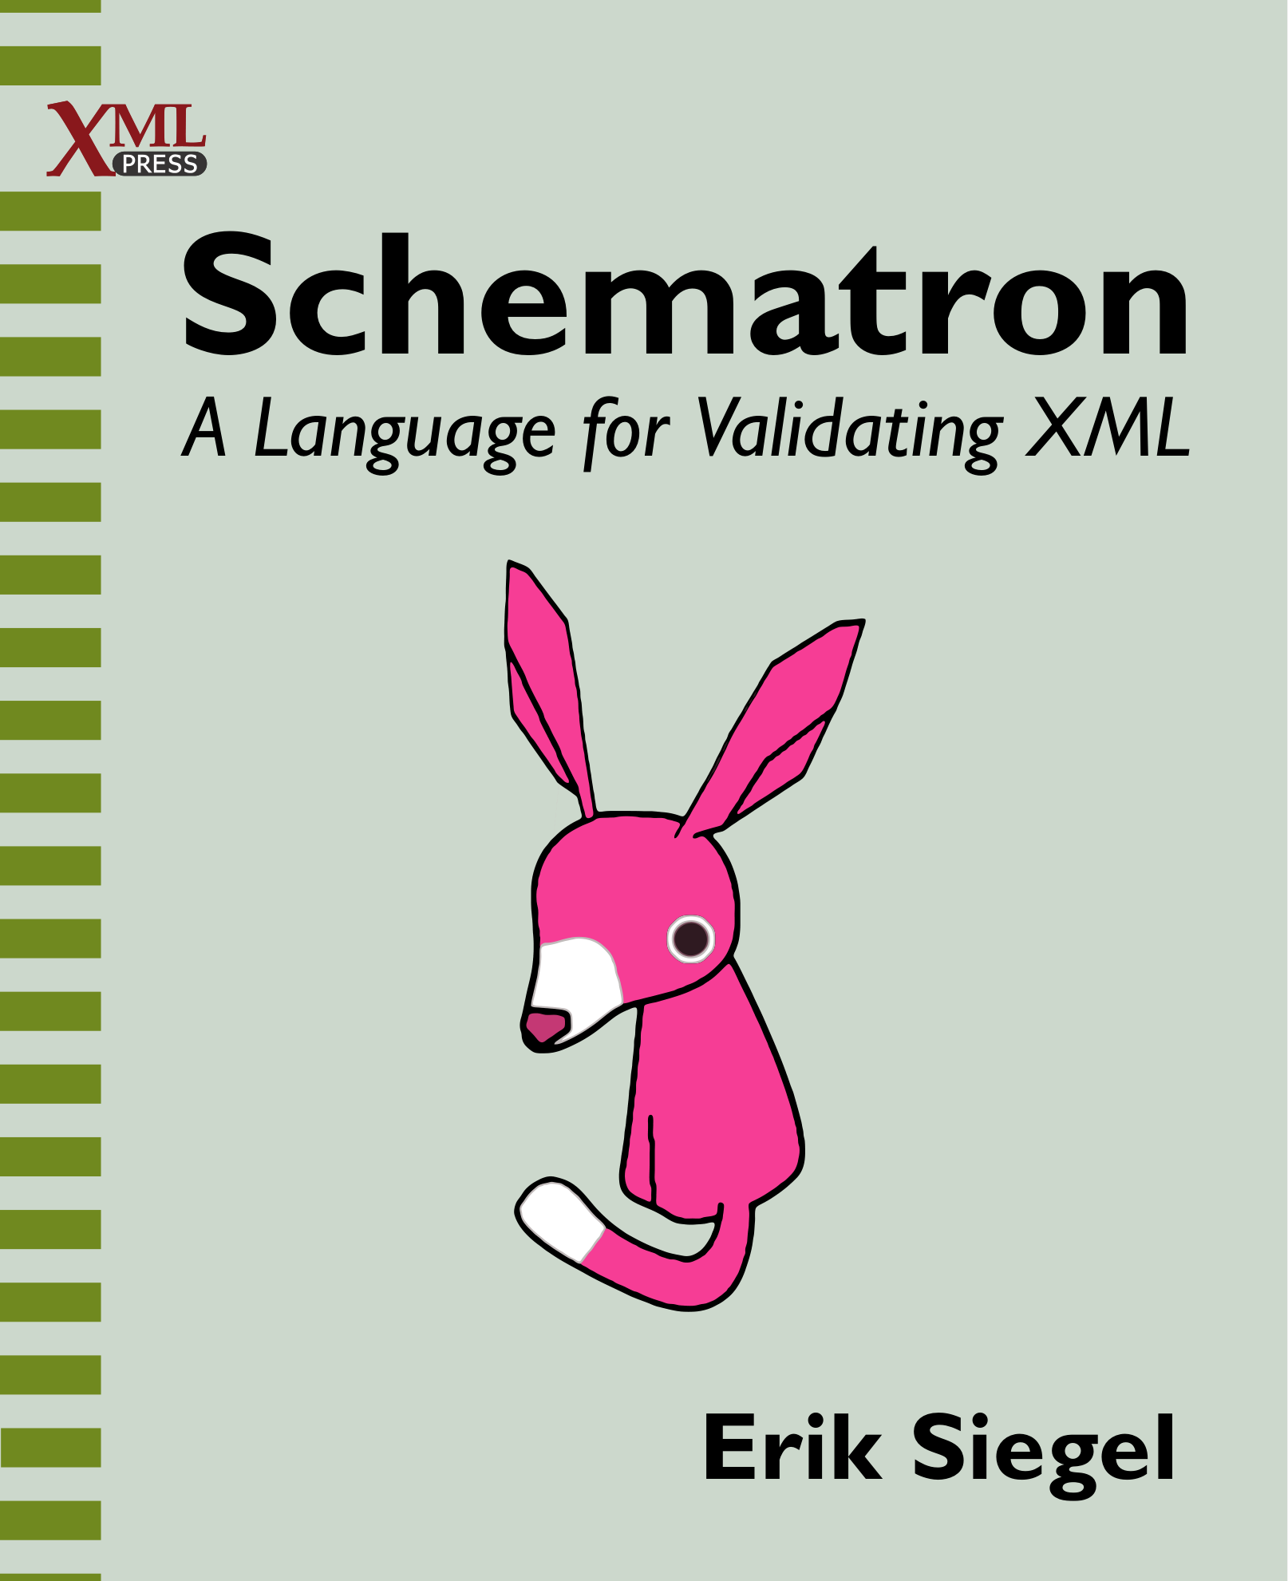
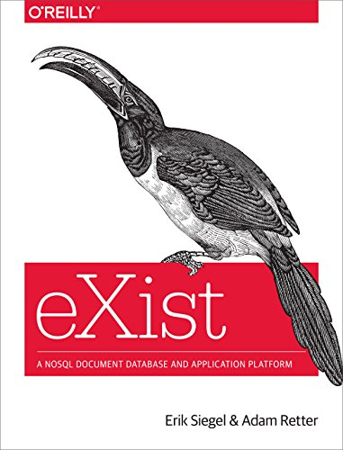
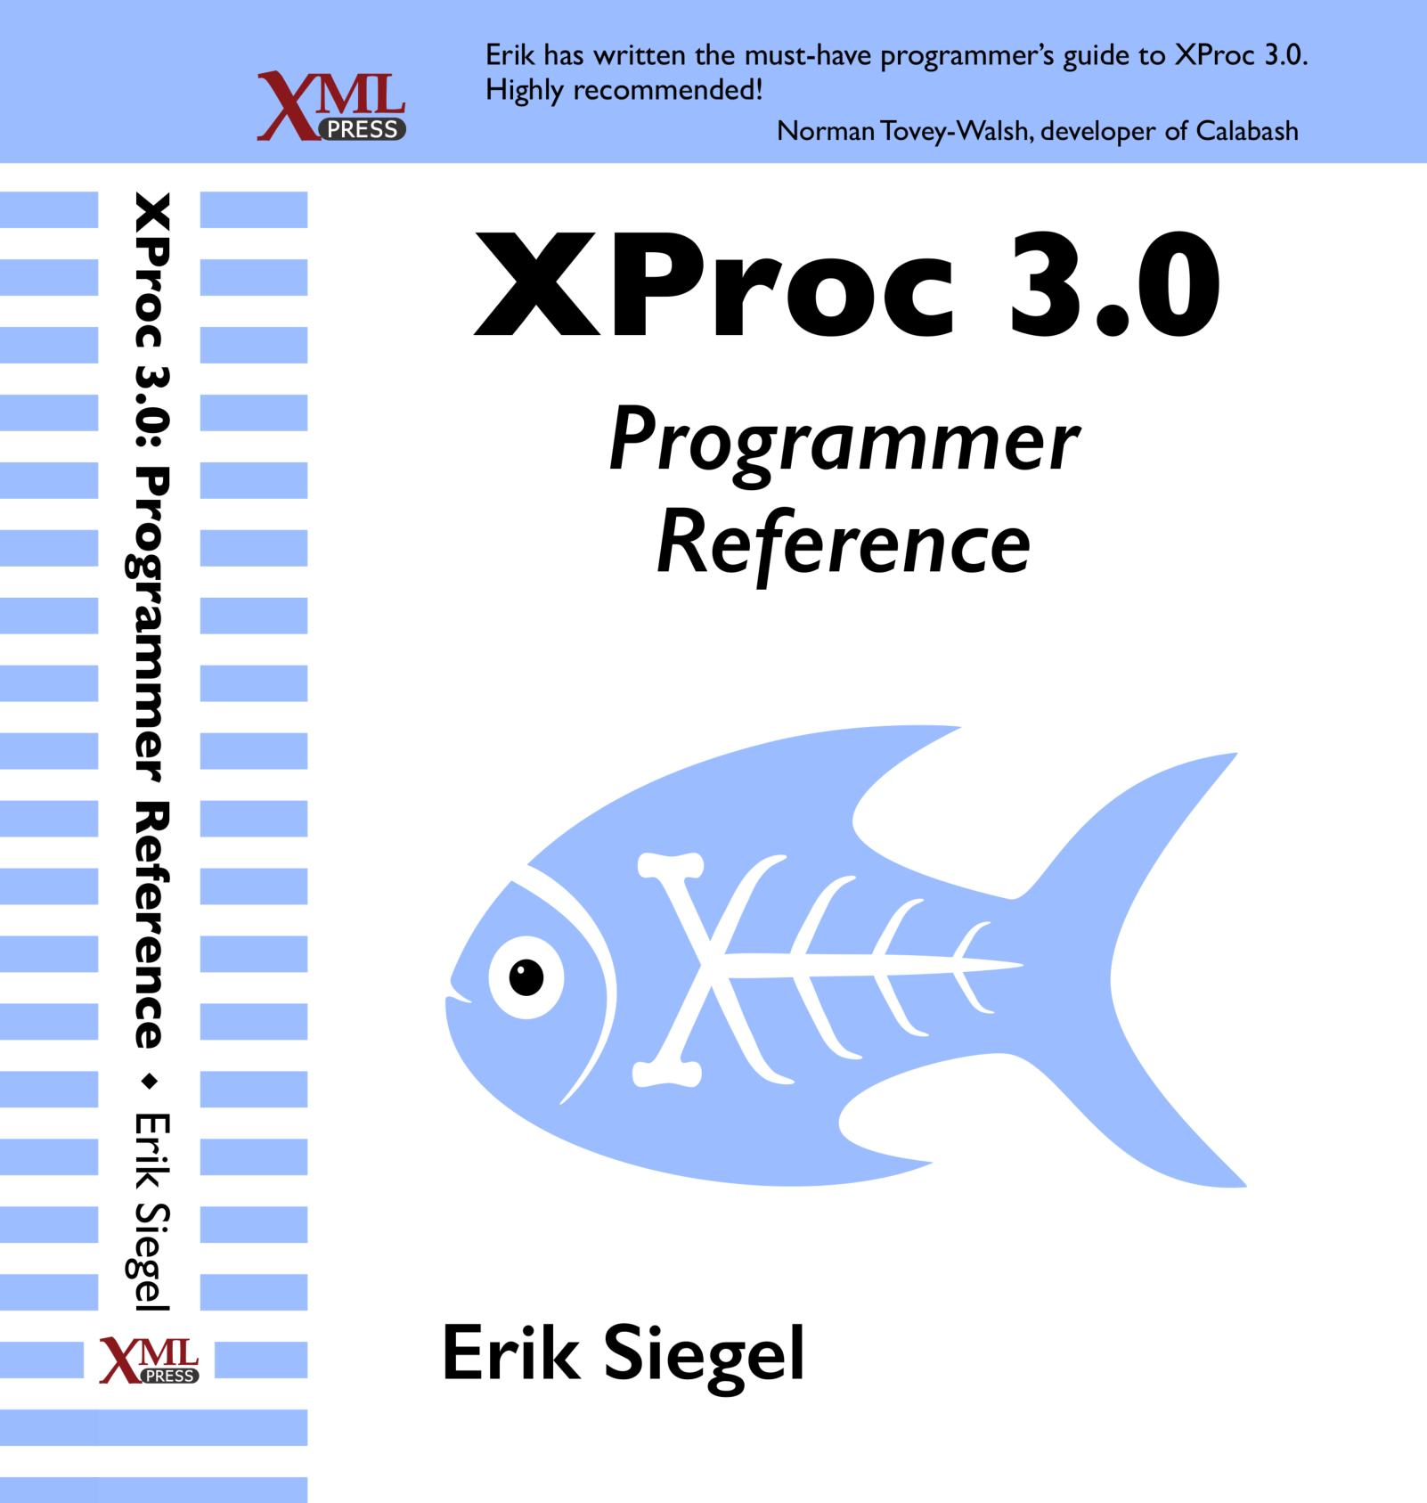
Introductions
Schematron in context (of other validation languages)
How to apply Schematron (with SchXslt, in Oxygen, etc.)
Basics (patterns, rules, asserts/reports, value-of, variables, namespaces)
Advanced (diagnostics, phases, abstract rules/patterns, includes)
Query Language Binding
Additional features (markup, flags, roles, etc.)
Some further examples and recipes
Appendices:
XPath technology primer
Introduction to namespaces
Schematron & SVRL reference
Introduction to SQF
Additional reading
My other books

Slide 36

Questions?
Erik Siegel
www.xatapult.com
erik@xatapult.nl

